Slide 1
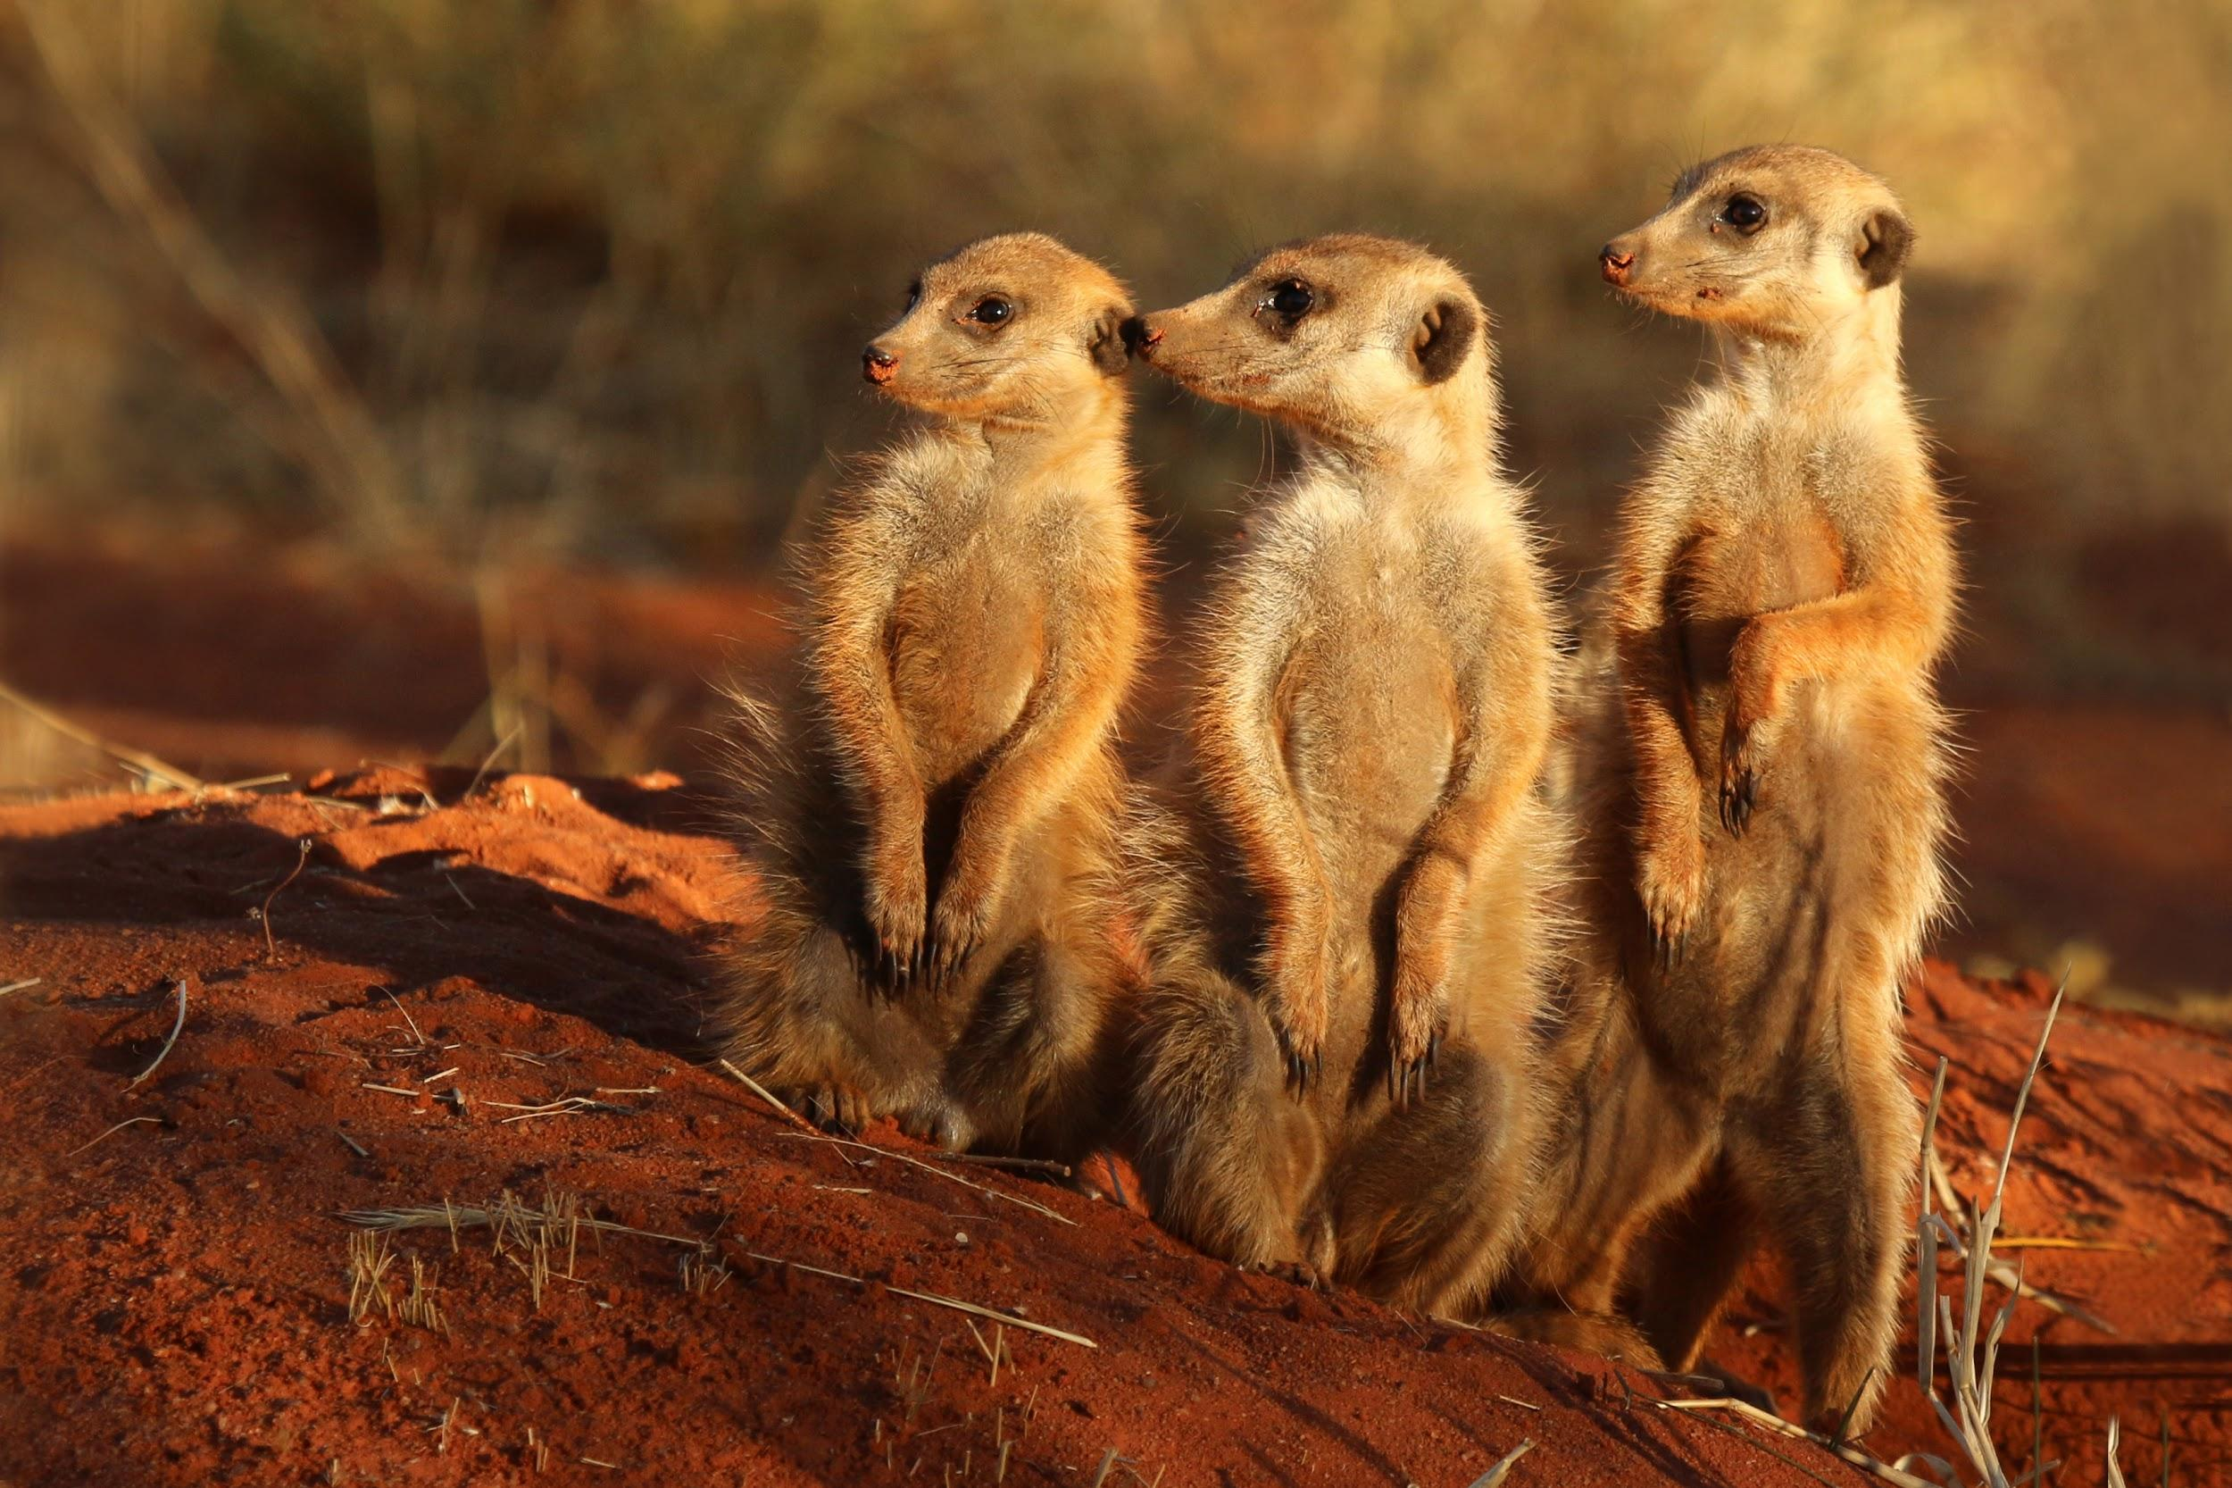
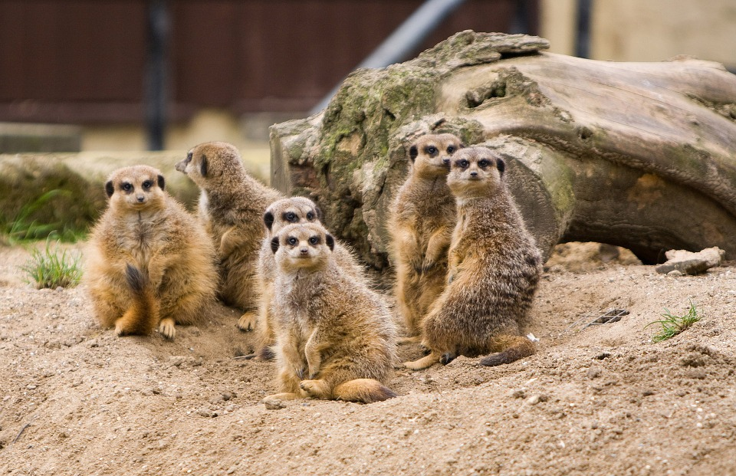
Down the meerkat hole - stay curious
Modelling and Digital Science - Data Science
Dr. Vukosi Marivate - Senior Data Scientist
Ms. Nyalleng - Senior Data Scientist
Data Science Africa 2017
Notes:
A tool for decision making for law enforcement as well as governing agencies.

Slide 2
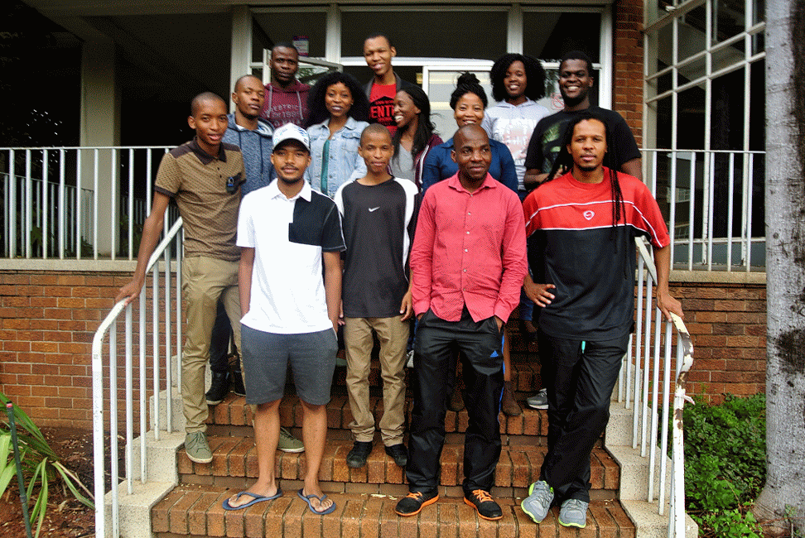
The Squad @ CSIR

Slide 3
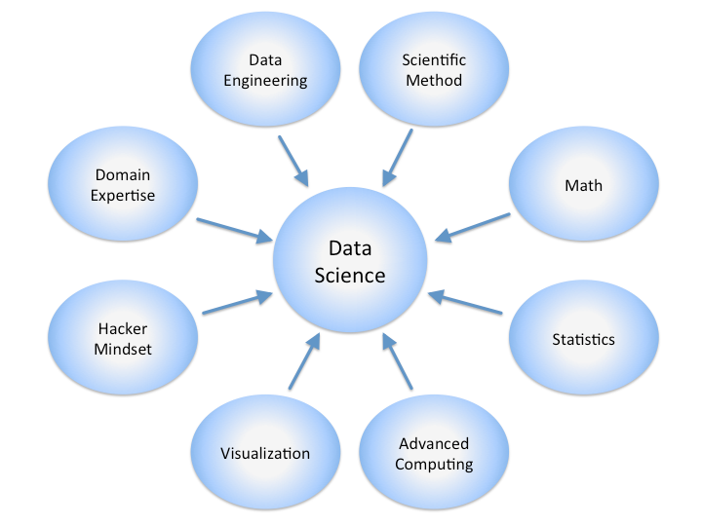




Who we are
CSIR Modelling and Digital Science - Data Science:
Machine Learning, Artificial Intelligence
Information Security Applications
Fraud
Anomaly Detection
Spam
Social Media Mining
Behavioural Modelling
Data Science approach to problems

Slide 4
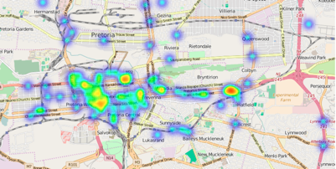
The start: Social Media Mining
We would like to be able to build tools to help organisations (law enforcement, government, NGOs) in understanding trends in crime and public safety.
Providing real-time, on ground, awareness as incidents occur.
Why Social Media:
Availability of point data
Allowed us to build analytics that can be used in other applications
Further understanding of spoken languages in South Africa

Slide 5

Social Media Analytics Research
Research Avenues
Language Understanding
Classification Models For Incidents
Trust Models
Behavioural Modelling
Privacy and Ethics

Slide 6


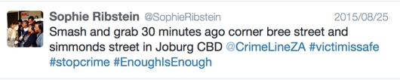
Example Data
{u'contributors': None,
u'coordinates': None,
u'created_at': u'Mon Apr 13 09:19:08 +0000 2015',
u'entities': {u'hashtags': [{u'indices': [109, 118], u'text': u'............'}],
u'symbols': [],
u'trends': [],
u'urls': [],
u'user_mentions': [{u'id': 3062199549,
u'id_str': u'3062199549',
u'indices': [3, 18],
u'name': u'’',
u'screen_name': u''}]},
u'favorite_count': 0,
u'favorited': False,
u'filter_level': u'low',
u'geo': None,
u'id': 587545543385165824,
u'id_str': u'587545543385165824',
u'in_reply_to_screen_name': None,
u'in_reply_to_status_id': None,
u'in_reply_to_status_id_str': None,
u'in_reply_to_user_id': None,
u'in_reply_to_user_id_str': None,
u'lang': u'en',
u'place': None,
u'possibly_sensitive': False,
u'retweet_count': 0,
u'retweeted': False,
u'retweeted_status': {u'contributors': None,
u'coordinates': None,
u'created_at': u'Mon Aug 25 09:17:13 +0000 2015',
u'entities': {u'hashtags': [{'}],
u'symbols': [],
u'trends': [],
u'urls': [],
u'geo': None,
u'id': 587545060159447040,
u'id_str': u'587545060159447040',
u'in_reply_to_screen_name': None,
u'in_reply_to_status_id': None,
u'in_reply_to_status_id_str': None,
u'in_reply_to_user_id': None,
u'in_reply_to_user_id_str': None,
u'lang': u'en',
u'place': None,
u'possibly_sensitive': False,
u'retweet_count': 2,
u'retweeted': False,
u'source': u'<a href="http://www.twitter.com" rel="nofollow">Twitter for BlackBerry</a>',
u'text': u"Smash and Grab 30 minutes ago corner bree street and simmonds street in Joburg CBD @CrimeLinezA #victimsafe #stopcrime #EnoughIsEnough",
u'truncated': False,
u'user': {u'contributors_enabled': False,
u'created_at': u'Wed Feb 25 15:04:40 +0000 2015',
u'default_profile': True,
u'default_profile_image': False,
u'description': u'Proverbs 14:1 The wisest of women\xa0builds her house, but folly with her own hands\xa0tears it down. Orlando Pirates fan!!!',
u'favourites_count': 1,
u'follow_request_sent': None,
u'followers_count': 121,
u'following': None,
u'friends_count': 378,
u'geo_enabled': False,
u'id': 3062199549,
u'id_str': u'3062199549',
u'is_translator': False,
u'lang': u'en',
u'listed_count': 0,
u'location': u'Mariannhill (Luganda)',
u'name': u'MaNdlovu Dlakadla',
u'notifications': None,
u'profile_background_color': u'C0DEED',
u'profile_background_image_url': u'http://abs.twimg.com/images/themes/theme1/bg.png',
u'profile_background_image_url_https': u'https://abs.twimg.com/images/themes/theme1/bg.png',
u'profile_background_tile': False,
u'profile_banner_url': u'https://pbs.twimg.com/profile_banners/3062199549/1424877462',
u'profile_image_url': u'http://pbs.twimg.com/profile_images/587355740505055232/B3JPPUOa_normal.jpg',
u'profile_image_url_https': u'https://pbs.twimg.com/profile_images/587355740505055232/B3JPPUOa_normal.jpg',},
u'source': u'<a href="http://twitter.com/download/android" rel="nofollow">Twitter for Android</a>',
u'text': u"RT @Nhleh_Dlakadla: NtombAce doesn't need any immunity or to win HOH....we got their backs till the end baba #BBMzansi",
u'timestamp_ms': u'1428916748268',
u'truncated': False,
u'user': {u'contributors_enabled': False,
u'created_at': u'Mon
u'default_profile': True,
u'default_profile_image': False,
u'description': u'E…………...', u'profile_text_color': u'333333',
u'profile_use_background_image': True,
u'protected': False,
u'screen_name': u'........’}
}
Notes:
Dont ovewrite CSIR

Slide 7
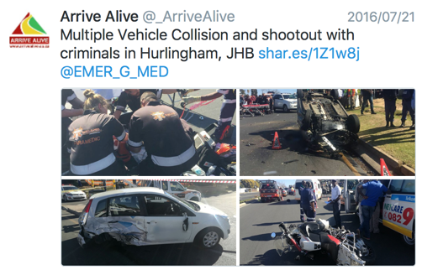
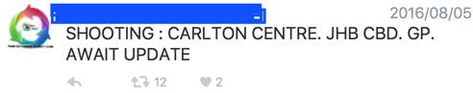
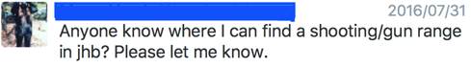
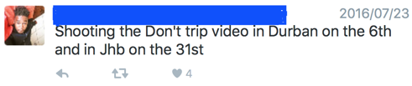
Research: Language Understanding
Context Matters!!!!
Notes:
Dont ovewrite CSIR

Slide 8
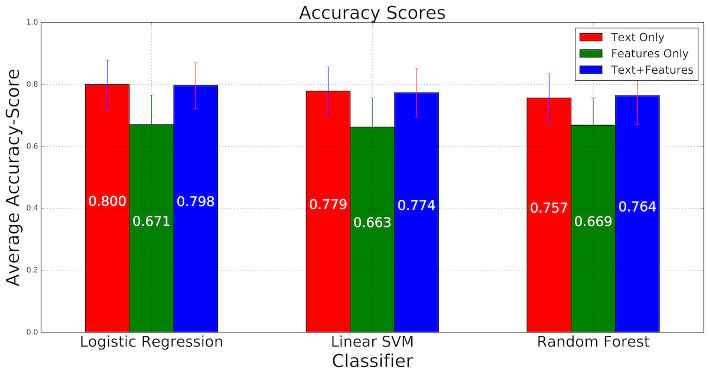

Research: Incident Classification
Incident Detection and Classification
Crime Incident or Not?
Machine Learning
1200 labelled instances (60% not crime related)
26000 unlabelled
Train predictive models
Features:
Text (words)
Social Graph Features (network of friends, likes, retweets etc.)
Words + Social Graph
Summaries
Crowdsourcing
Dr. Vukosi Marivate, Ms. Pelonomi Moiloa (CSIR Intern): Catching Crime: Detection of Public Safety Incidents using Social Media (PRASA 2016)
Notes:
Dont ovewrite CSIR

Slide 9
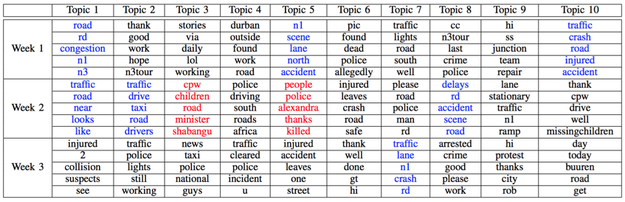
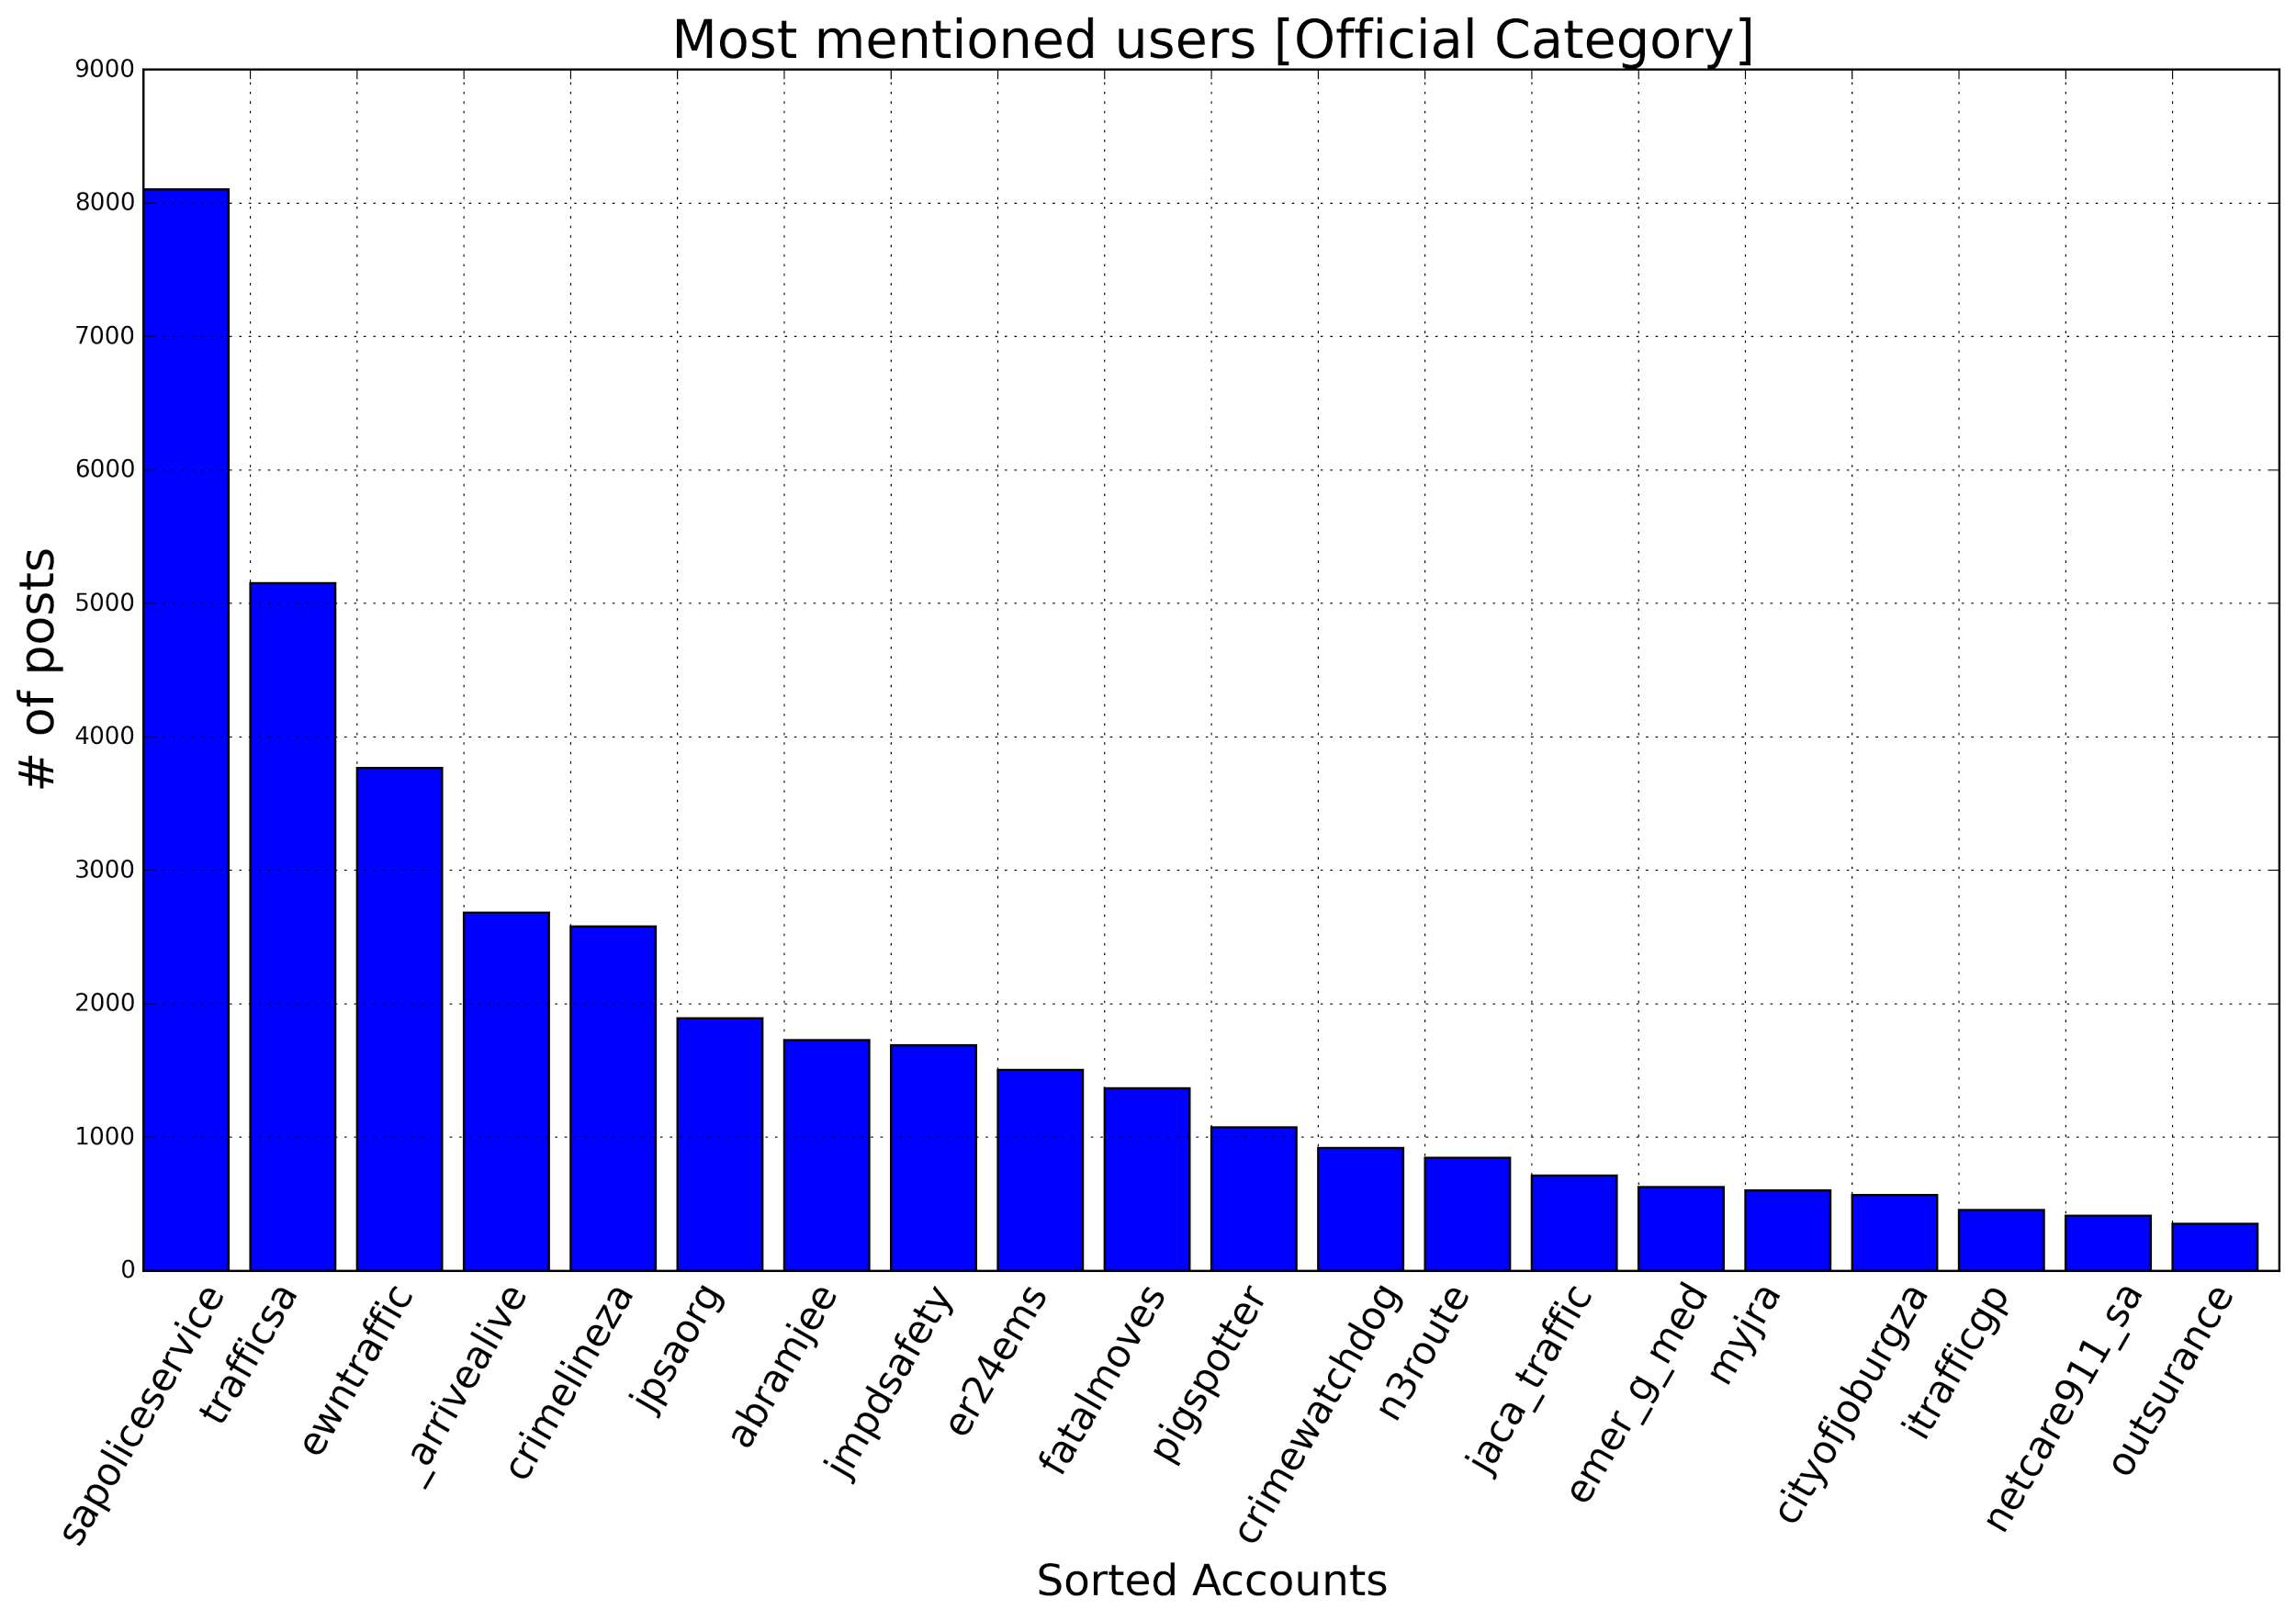
Research: Incident Classification
Incident Classification
Crime Incident or Not?
Topic Modelling
Public Safety or Crime Topics
Dr. Vukosi Marivate, Extracting South African safety and security incident patterns from social media (PRASA 2015)
Notes:
Dont ovewrite CSIR

Slide 10
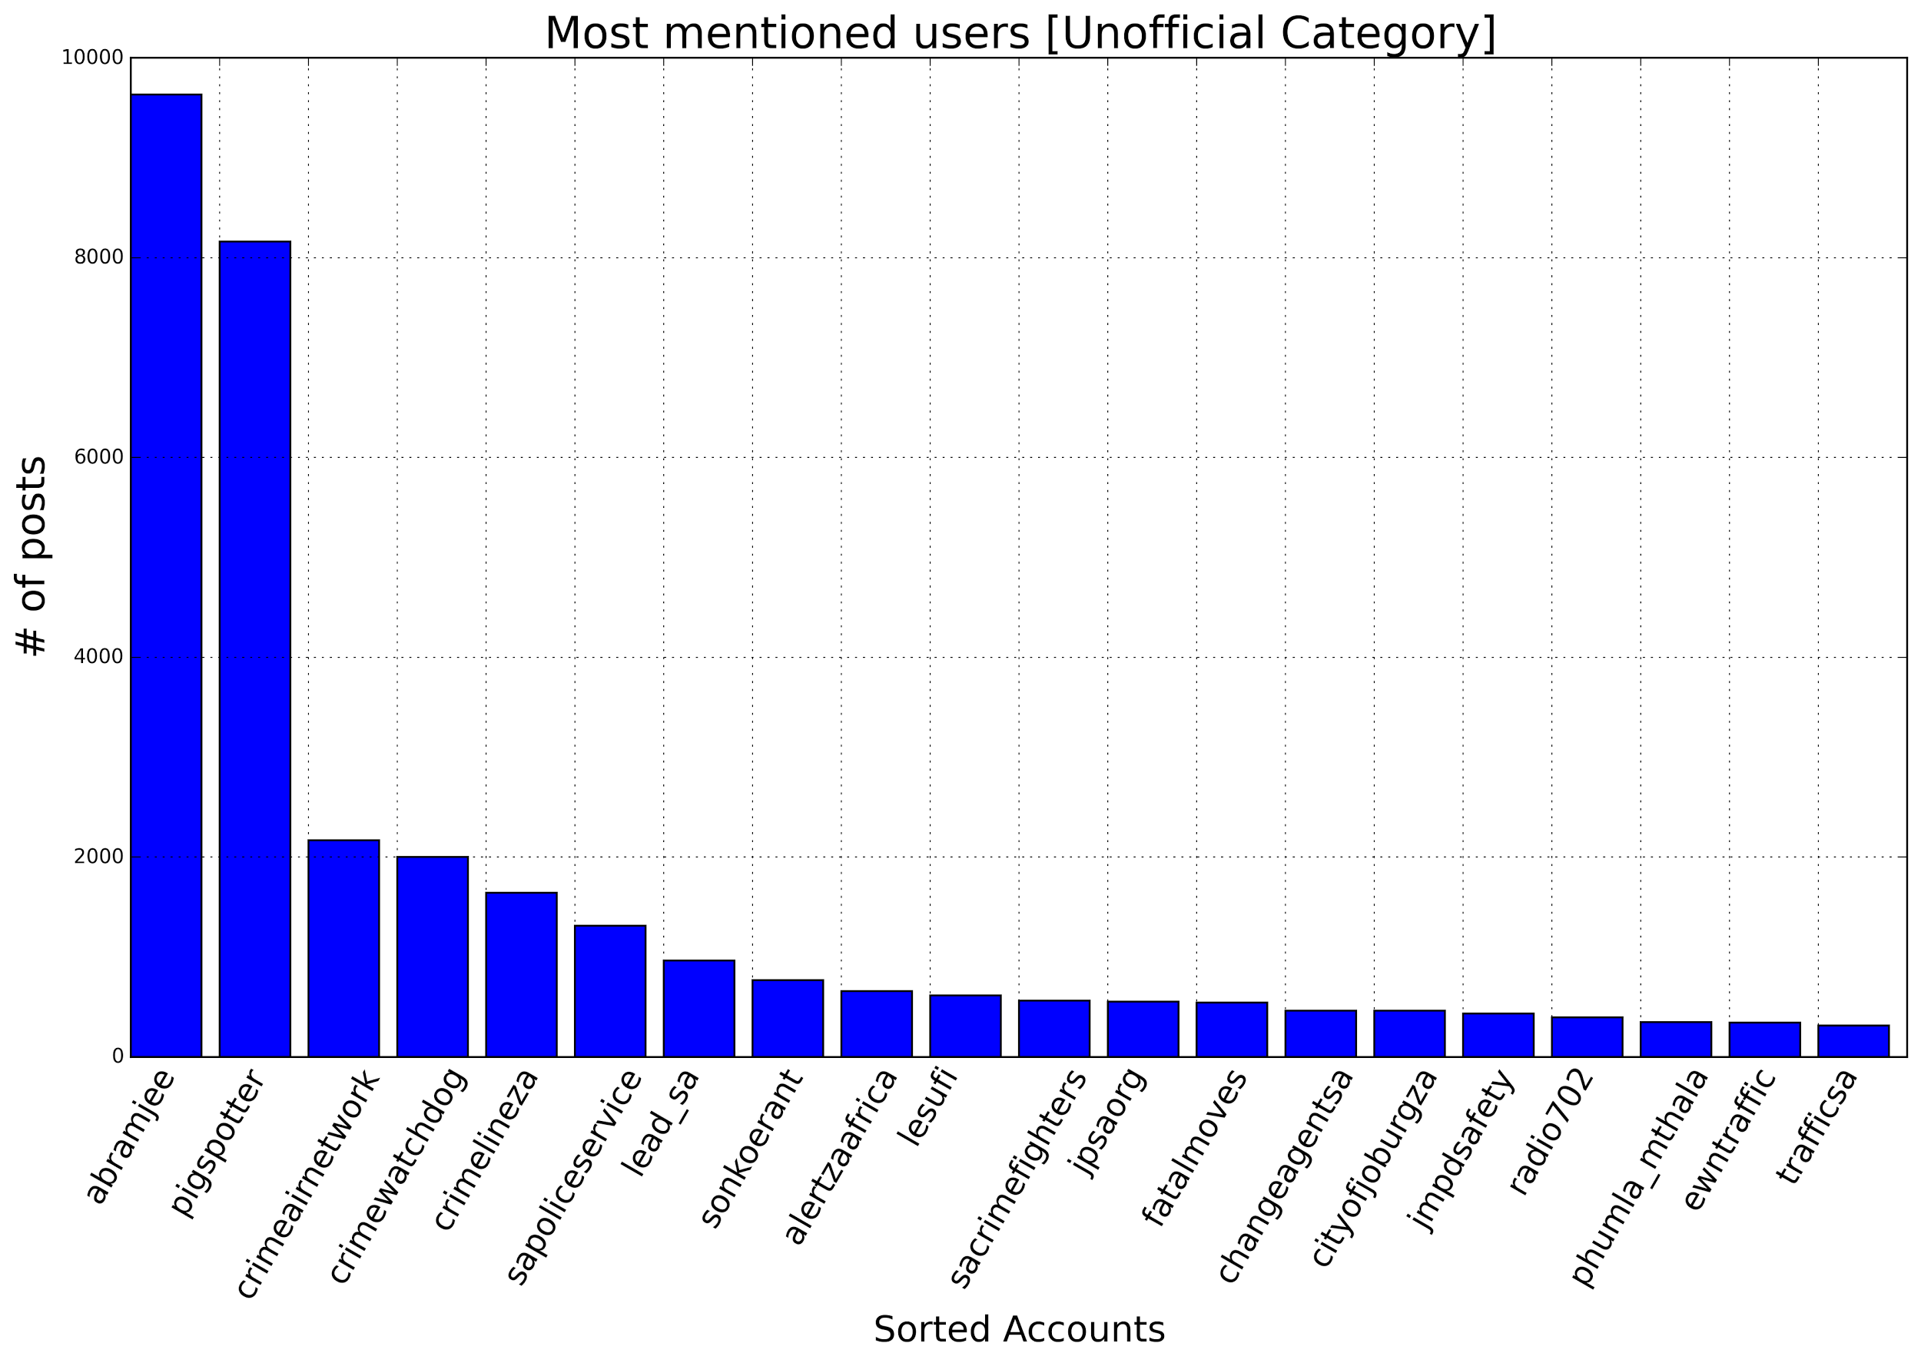
Research: Trust Models
Trust Models (Who to believe?)
More trust: Multiple users experience same incident, same user area etc.
Less trust: Trending topic spam, user in different location to incident, etc.
Who is Authority?
Dr. Vukosi Marivate, Extracting South African safety and security incident patterns from social media (PRASA 2015)
Notes:
Dont ovewrite CSIR

Slide 11
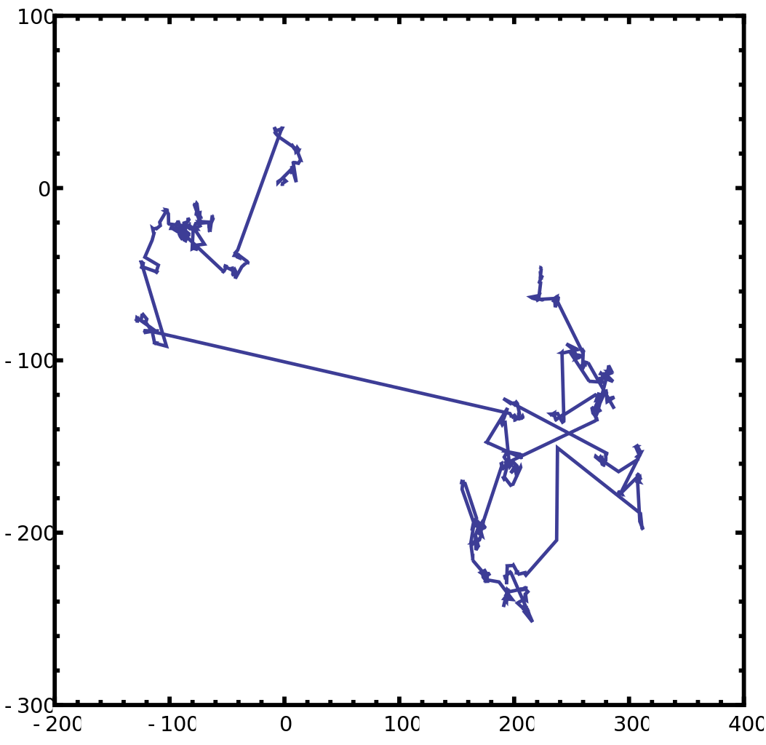
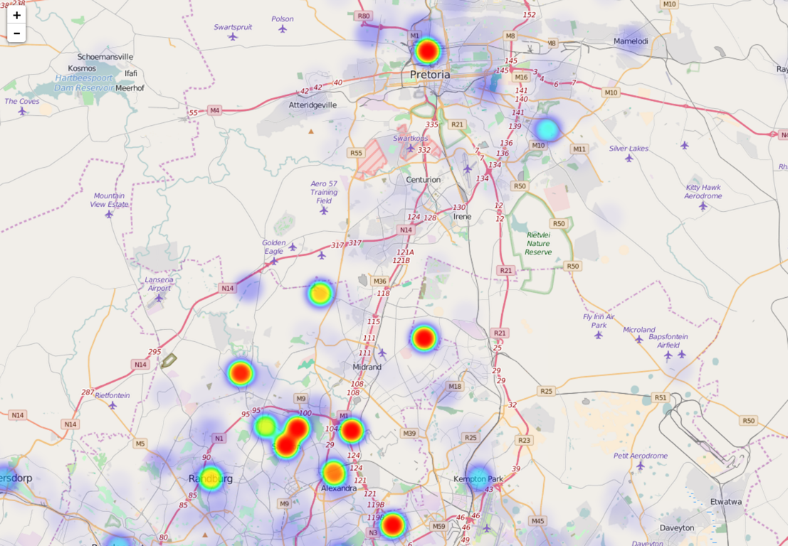
Research: Behavioural Modelling
Behavioural Models
Identified Incidents
Extract Locations
Some posts have GPS locations (most don’t)
Extract described locations from text
Mapping and Modelling movement of incidents
Goal: Understand behaviour
Better Resource Allocation
Identify Random vs. Targeted
Flight Models
Movement of incidents
Hotspots
Intervention efficacy prediction
Notes:
Dont ovewrite CSIR

Slide 12
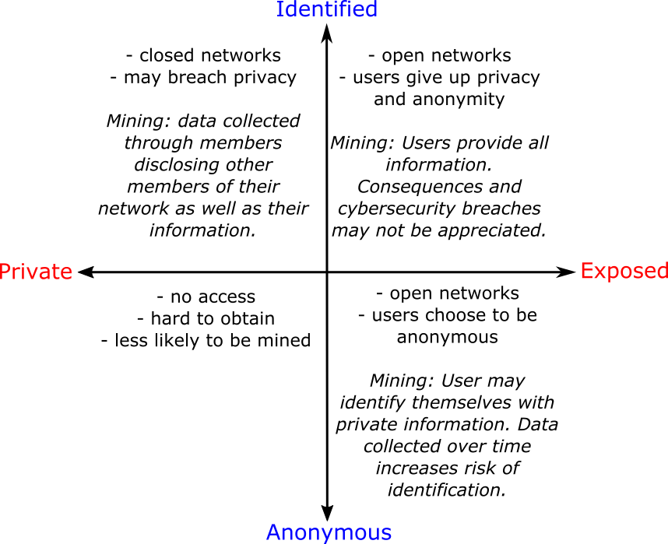
Research: Privacy and Ethics
Social Media Mining Ethics and User Privacy
Evolving Arena
POPI Act
Ethical Behaviour
Users Considerations
Preserving Privacy
Public post does not necessarily mean consent.
User might not have thought data would be used individually.
Better to use aggregations in some Cases.
Ms. Nyalleng Moorosi, Dr. Vukosi Marivate, Privacy In Mining Crime Data From Social Media: A South African Perspective (InfoSec 2015)
Ms. Nyalleng Moorosi, Dr. Mamello Thinyane, Dr. Vukosi Marivate, A Critical and Systemic Consideration of Data for Sustainable Development in Africa (2017)
Notes:
Dont ovewrite CSIR

Slide 13









Anatomy of the System
SIPHON
Raw Data
Extraction + Cleaning
Location Extraction
Classification
Text Cleaning Normalization
Brute Force
Score (Trust, Accuracy etc.)
Duplicate Removal
Named Entity Recognition
Analytics
HORDE
Crowdsource Engine

Slide 14
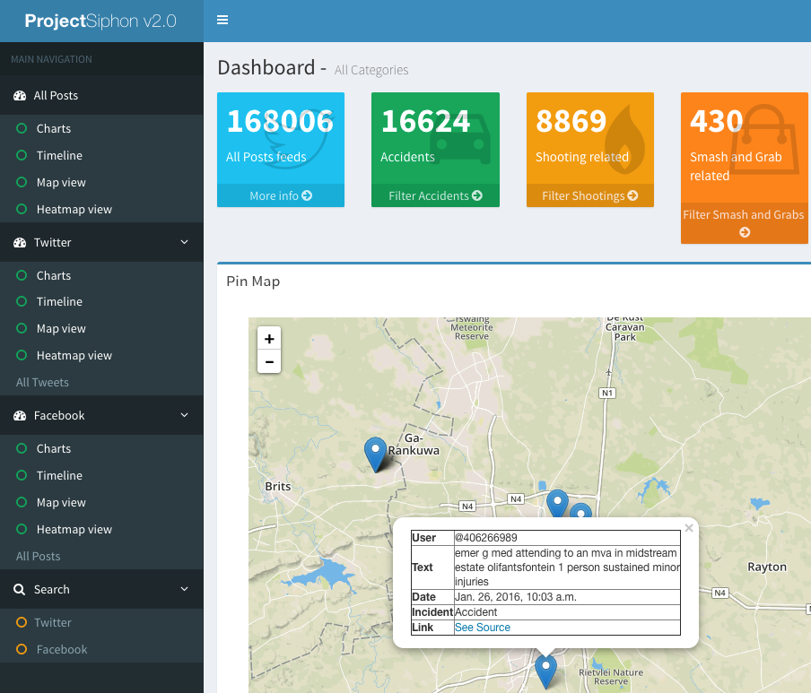
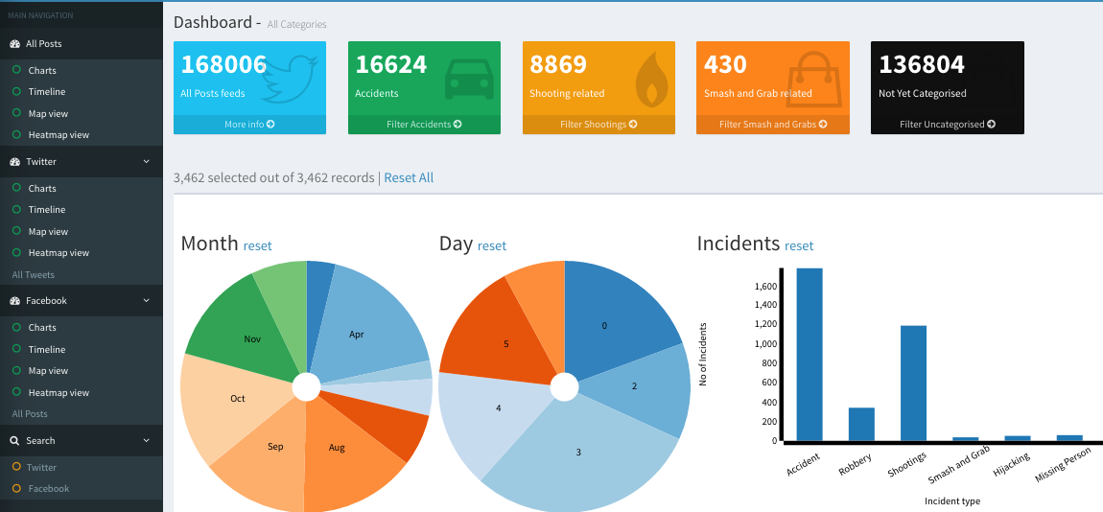
Data Science Applications: Public Safety and Crime Incident Detection
V4.0 ETA February 2018

Slide 15

Current Thrusts: Horde
Crowdsourcing engine for social media data we have collected
Active Learning Research
Better sampling data to show to humans
ML and Statistical Approaches
Work with MSc student Ms. Jessica Nemasisi

Slide 16
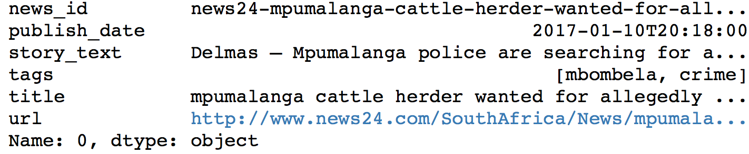
Current WIP Thrusts: Label Propagation
Using other data sources to get labels
Using News Articles to get tags
Propagating Tags
Linking News titles to social media posts.
Work with BSc student Mr. Donald Ntjana

Slide 17
Current WIP Thrusts: Realtime Event Detection
Looking at ways to identify events and automatically classify them as they happen
.
Streaming Discrete Wavelet Transforms
Streaming Graph Community Detection
Work with MSc student Ms. Jessica Nemasisi and researcher Tyrone Naidoo

Slide 18
Current WIP Thrusts: Real Law Enforcement Data
Looking at real data from local law enforcement
Analytics Delivery
Comparison of our system to
Work with Ms. Nyalleng Moorosi and Mr. Asive Dlaba

Slide 19
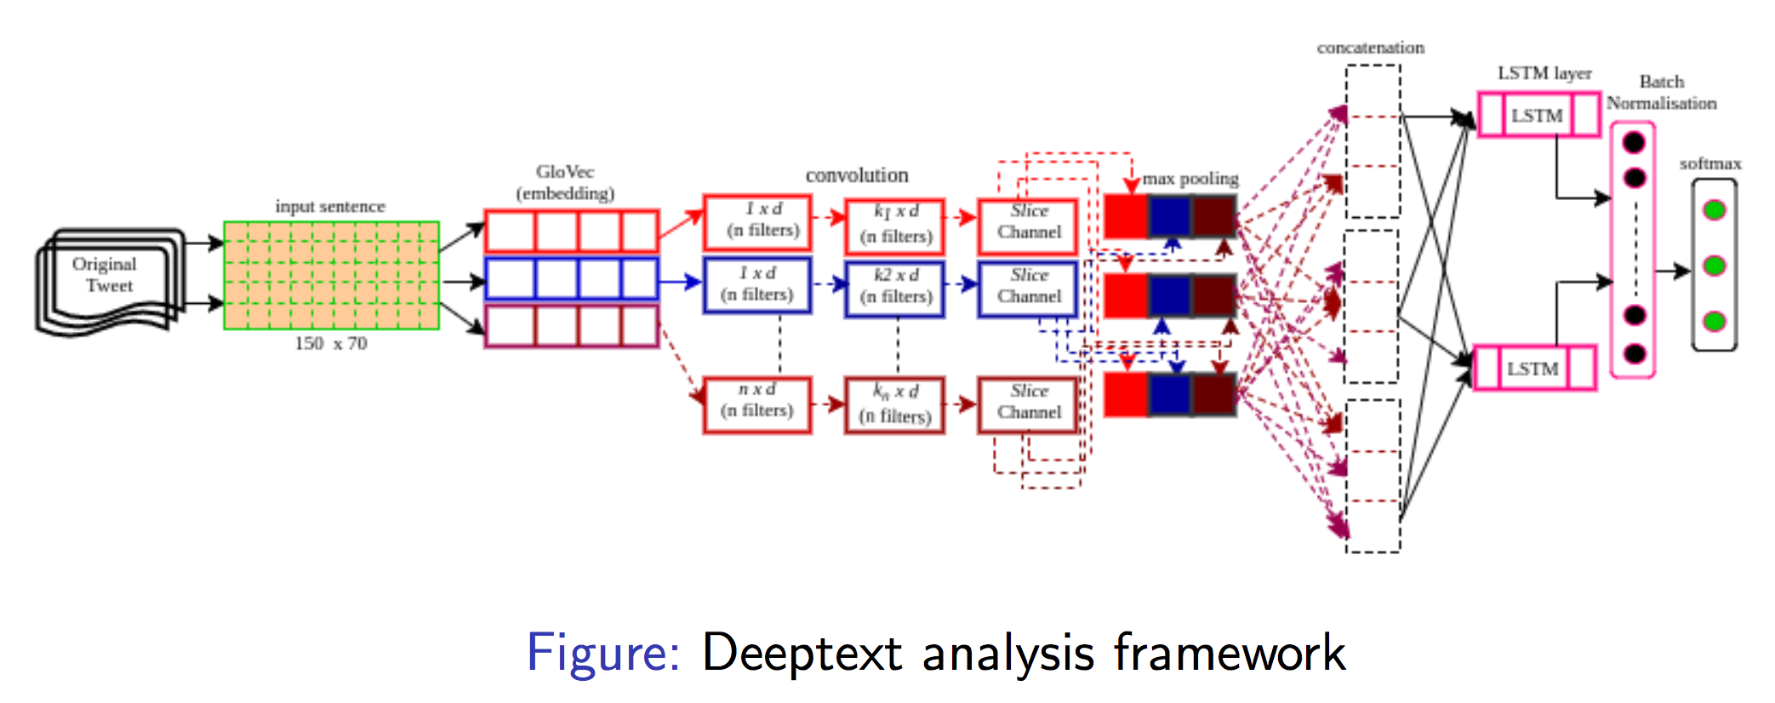
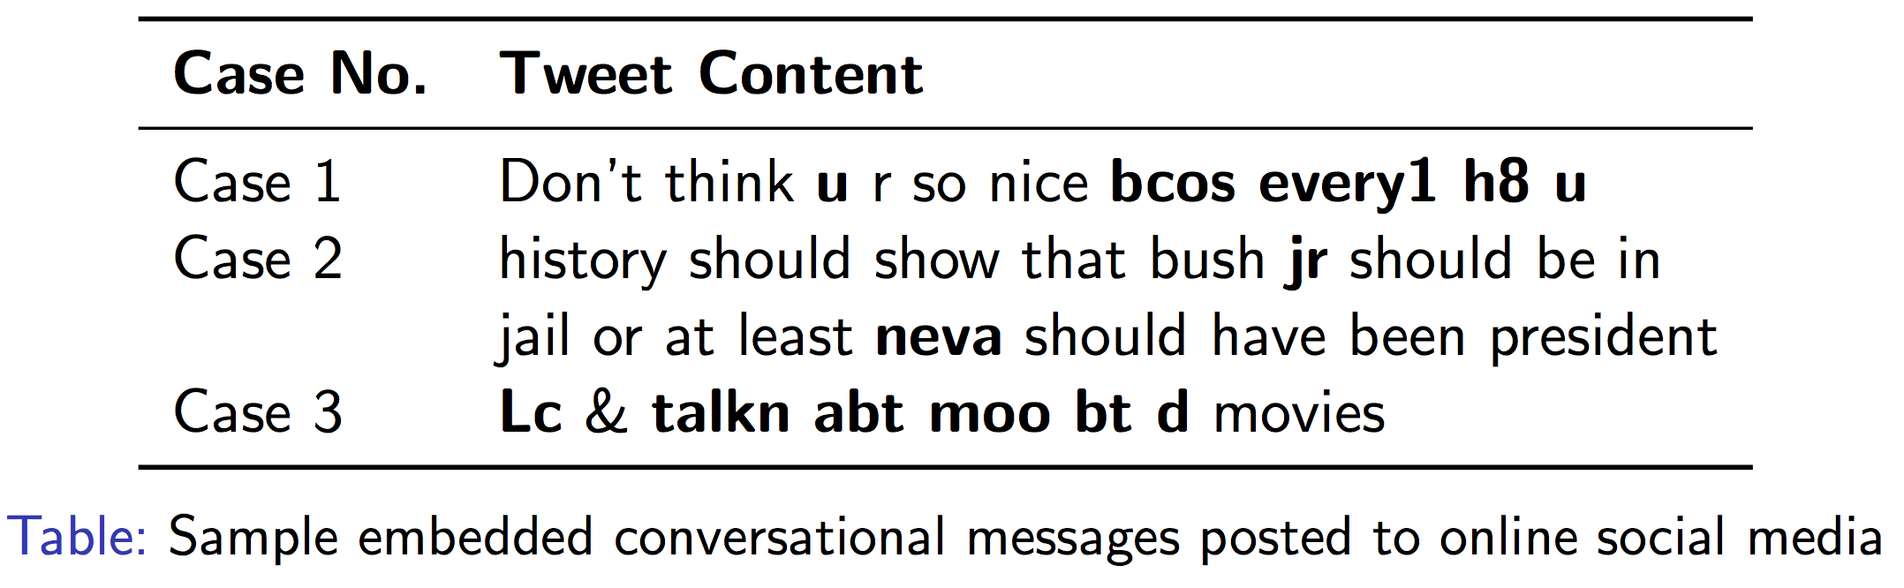
Current WIP Thrusts: Text Understanding
Work with PhD student Mr. A. Modupe

Slide 20
Questions
Find me:
vmarivate@csir.co.za
@vukosi
CSIR Modelling and Digital Science
It takes a village
Senior Researchers: Dr. Vukosi Marivate, Ms. Nyalleng Moorosi
Researchers/Developers: Asive Dlaba
Masters Students: Jessica Nemasisi, Patrick Monama, Tshepiso Mokoena
PhD Students: Abiodun Modupe, Nenekazi
Extended Team: LeeAnne Masilela (Wits), Thandile Xiphu (UCT), Yanga Sisilana(NMMU), Katlego Mogokonyane (NWU), Nhlamulo Chauke (UL), Pelonomi Moiloa (Wits), Gary Bezeidenhout (Wits), Nkosinathi Ndlovu (Wits), Abel Letoaba (SMU), Komana Morris (UL), Kaveshan Naidoo (UNISA), Purity Molala (UL), Tlou Boloka (NWU), Theron Khosa (UJ), Nolihle Gulwa (WSU), Wandisa Mfenguza (UFH), Ndamulelo Nemakhavhani (UCT), Nombuso Zondo (UKZN), Thulani Memory Khumalo (UCT), Zimkhitha Sijovu (UFH), Thulani Pride Ngonyama (UP), Olwethu Madikwa (WSU), Louisa Sommerville (UP), Carel Chachi (SMU)
Made with ♥ in Tshwane

Slide 21


Data Science for Impact and Decision Enablement (DSIDE)

Slide 22
DSIDE: The Program
Aim is to support capacity building in the ever growing field of Data Science.
DSIDE recruits vacation students (3rd year onwards ) over the period of 12 weeks (split 4 and 8).
Students participate in mentor-guided and learn-by-doing problem solving of real-world needs as presented by different stakeholders.

Slide 23
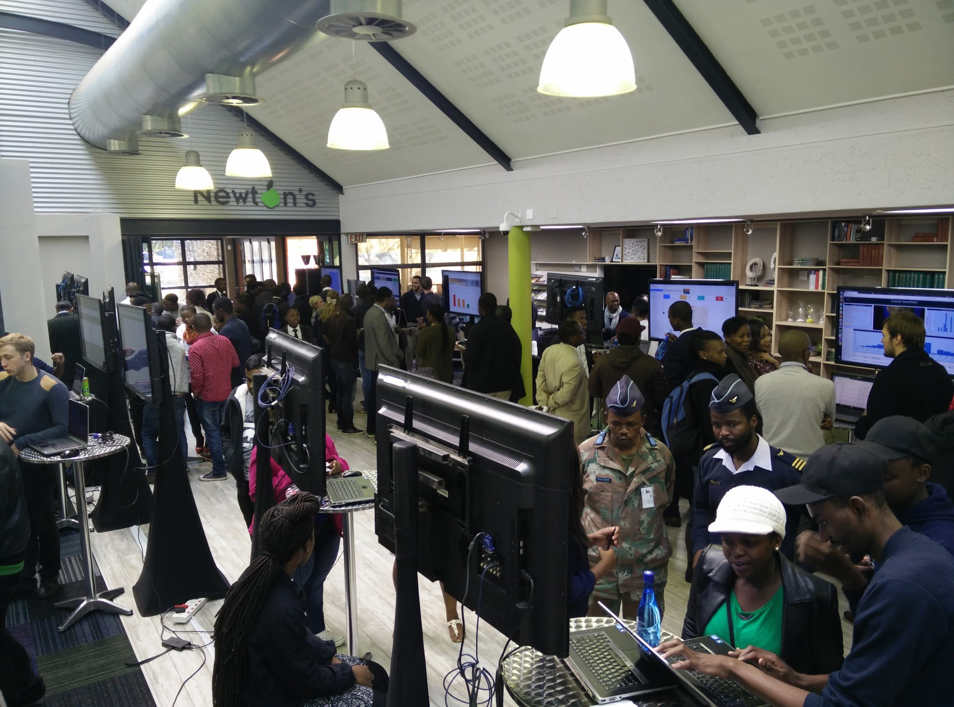
DSIDE: The Numbers
Multidisciplinary in Nature, Student Fields:
Actuarial Science
Computer Science
Engineering
Graphic Design
Journalism
Mathematics
Public Policy
Statistics

Slide 24
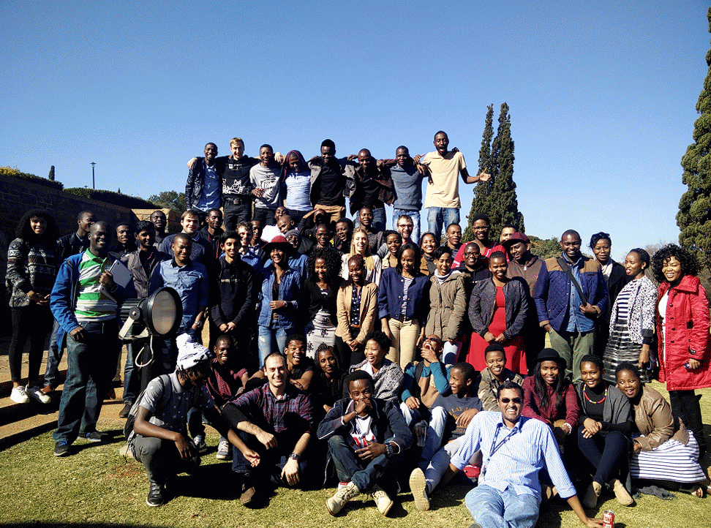
DSIDE: Call to Action
Visit our website for information on how you can get involved.
Universities or Academics
Get in touch, let us know about your Data Science programs and how we could work together (vmarivate@csir.co.za)
Companies/Organisations
Submit a Challenge
Attend Exhibition days
http://dsideweb.github.io
CSIR Vacancies

Slide 25
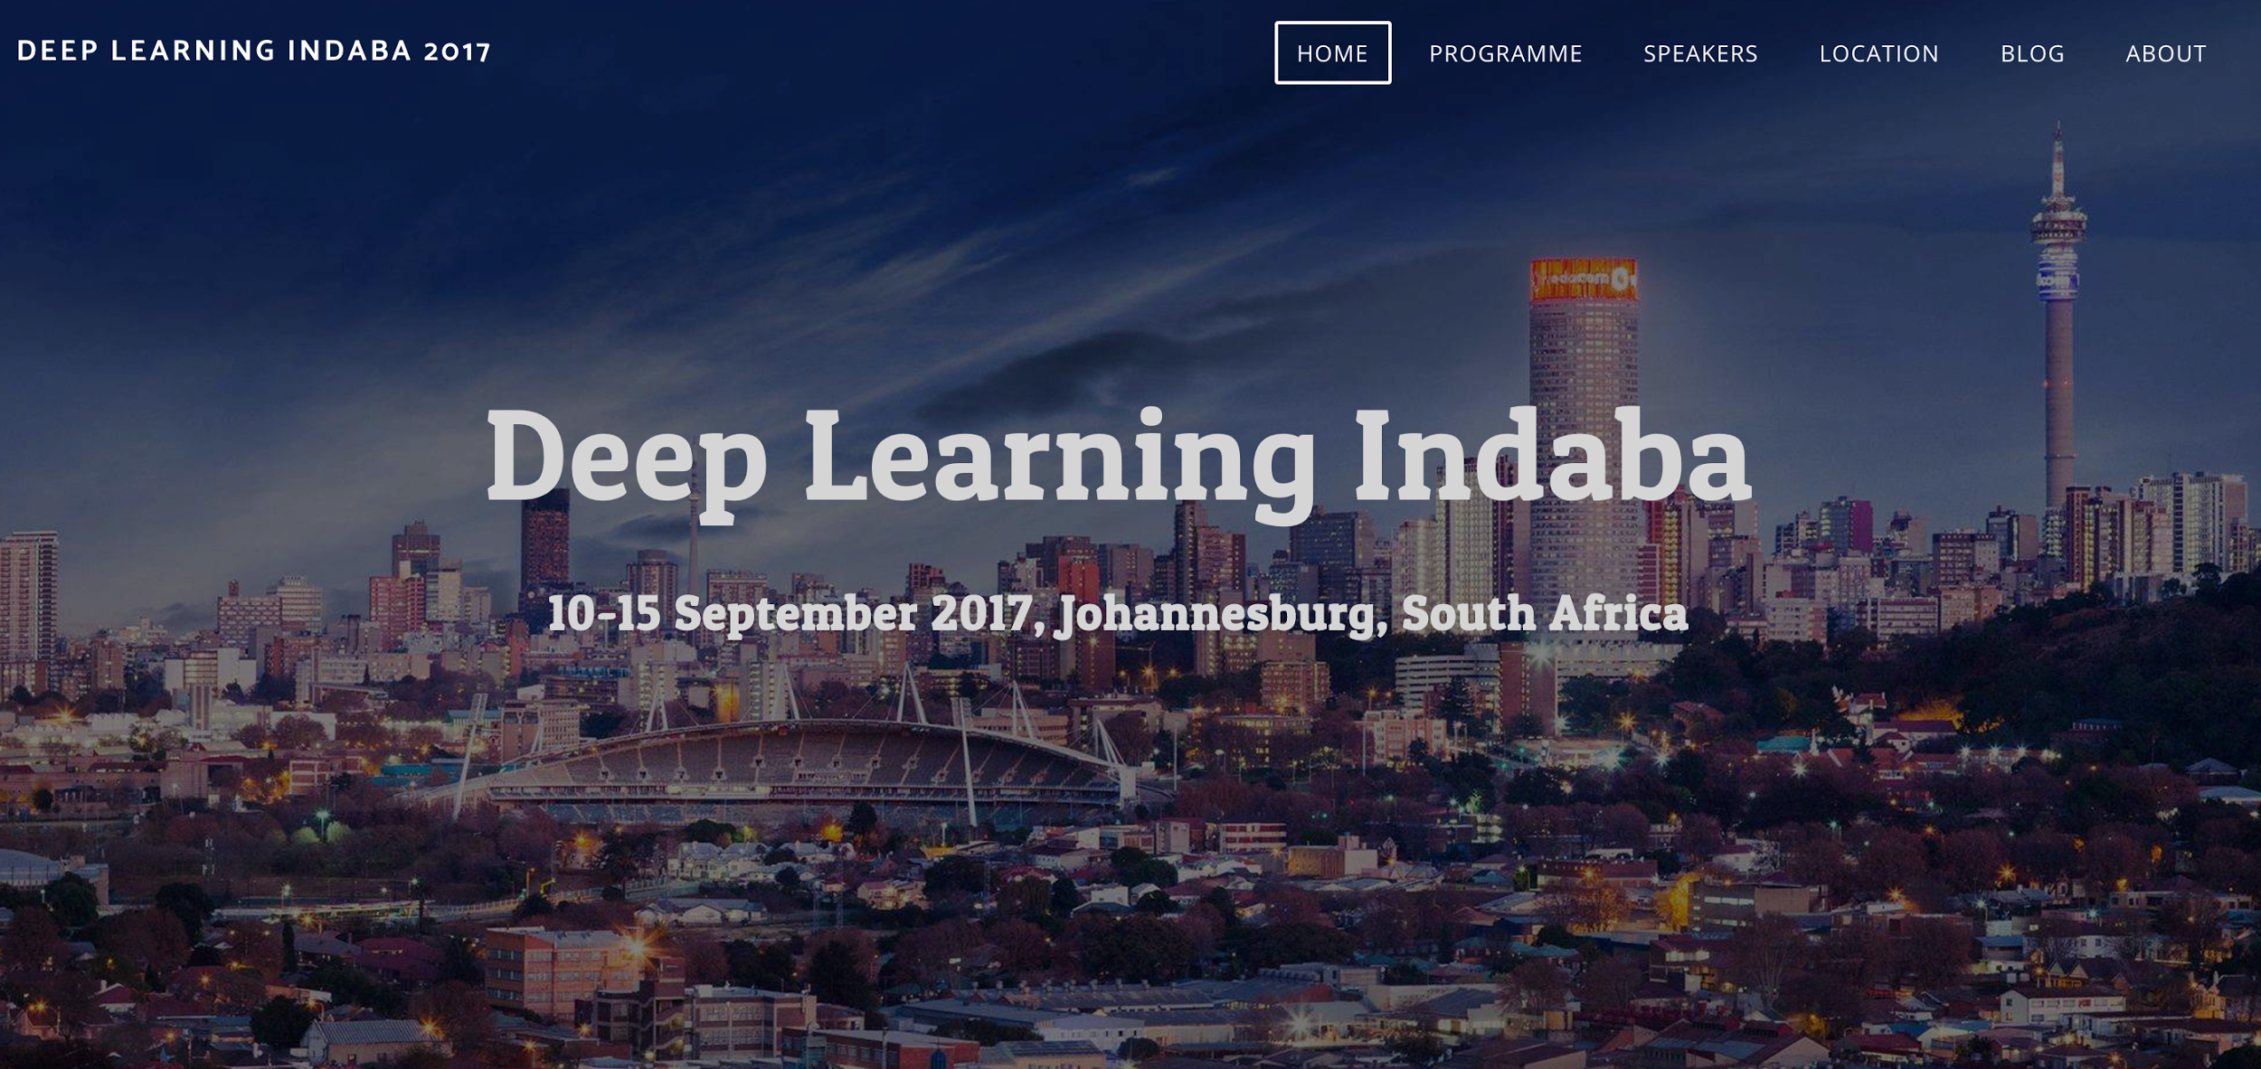











Slide 26
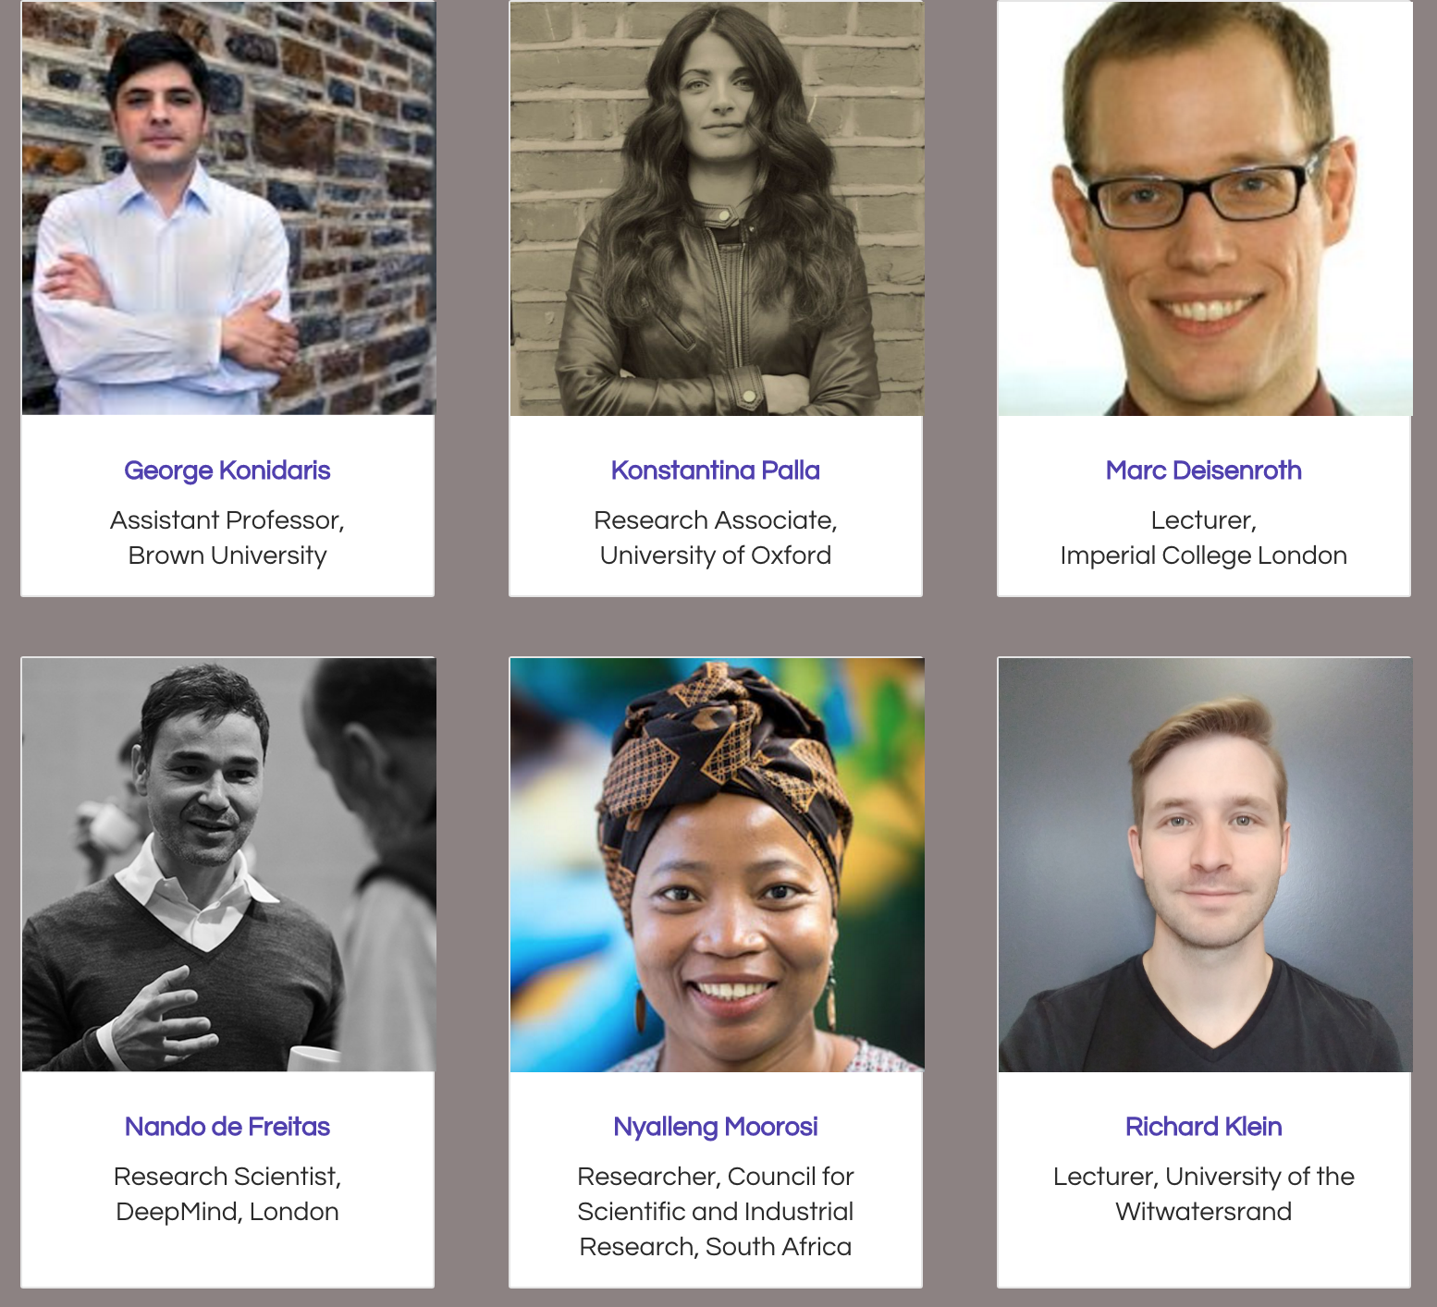
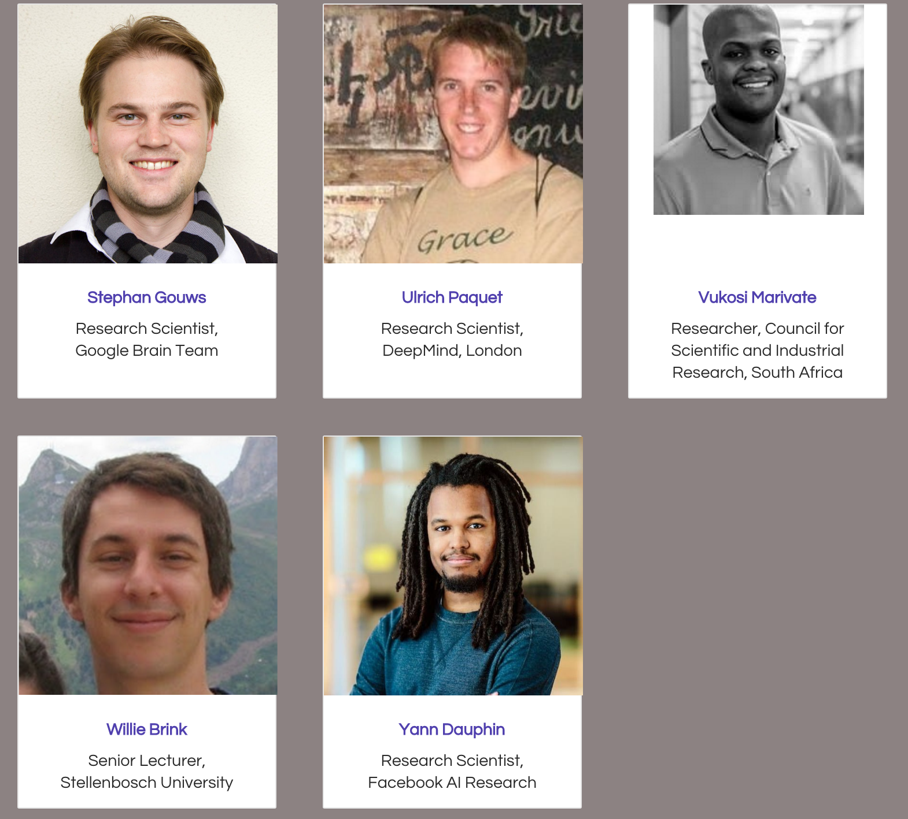
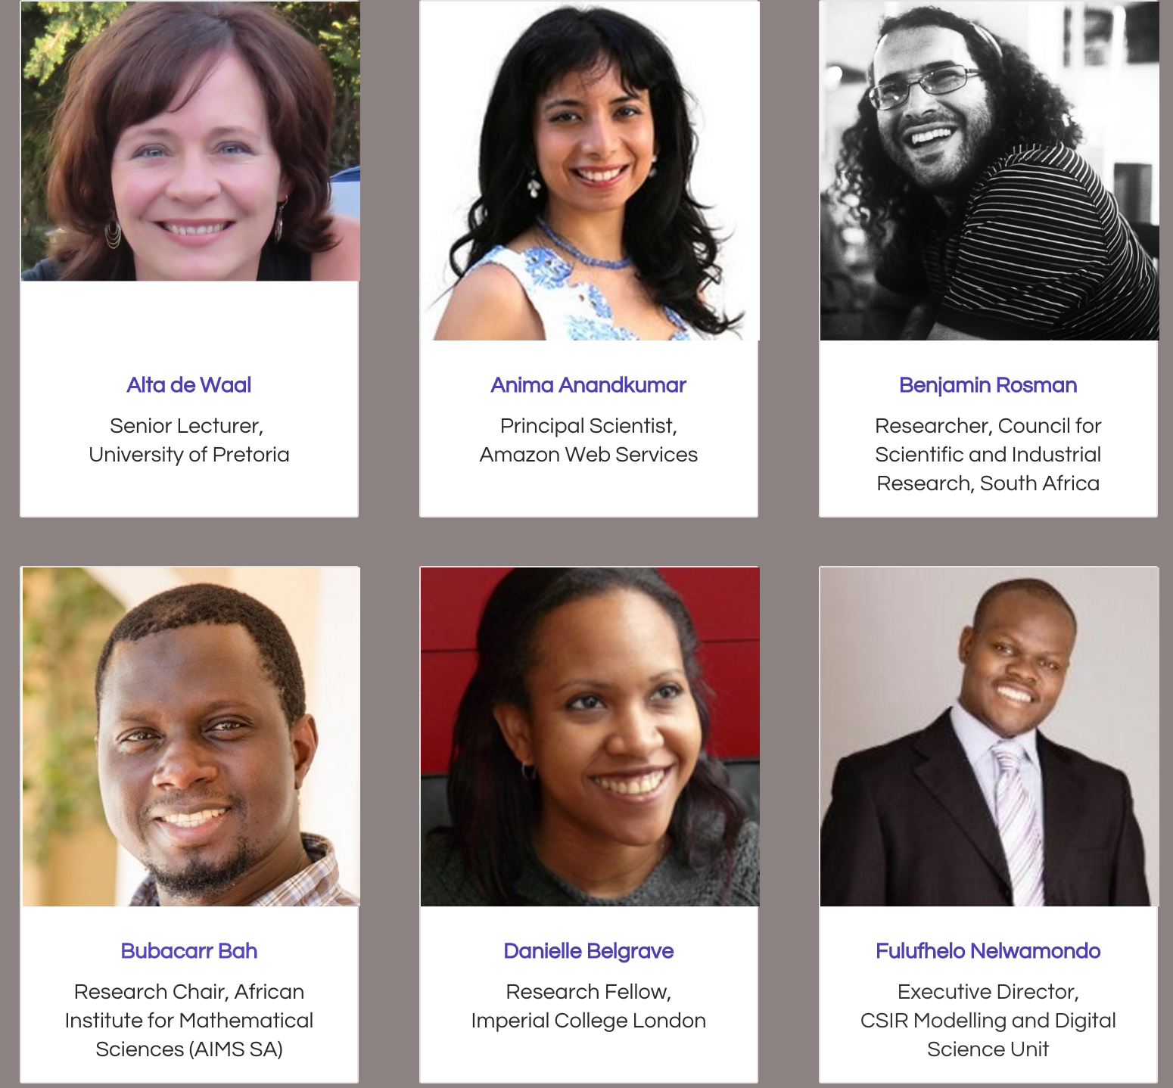
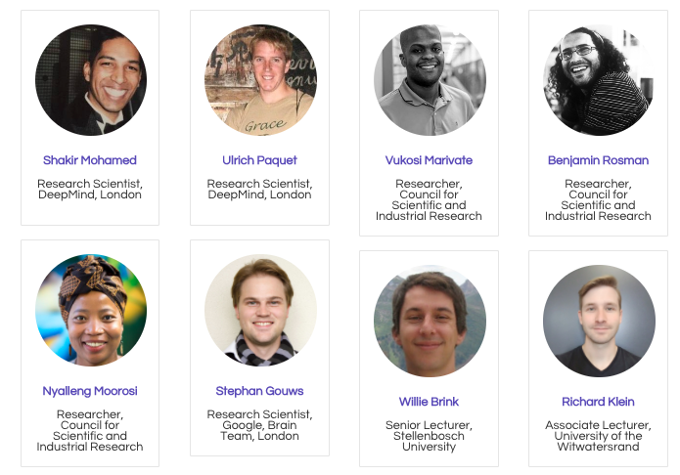
Deep Learning Indaba
10 - 15 September 2017
University of the Witwatersrand, Johannesburg, South Africa
http://deeplearningindaba.com

Slide 27
Deep Learning Indaba
10 - 15 September 2017
University of the Witwatersrand, Johannesburg, South Africa
http://deeplearningindaba.com
australia 2 | italy 2 | sa 1 | united kingdom 6
austria 2 | ivory coast 1 | senegal 16 | united states 6
botswana 12 | japan 1 | senegalese 1 | united states of america 1
canada 2 | johannesburg 1 |  | usa 4
congo (brazzaville) 1 | kenya 5 | south africa 360 | za 1
democratic republic of the congo 2 | latvia 1 | south africa 6 | zambia 1
denmark 4 | lesotho 1 | south african 2 | zimbabwe 2
egypt 2 | madagascar 2 | southafrica 1
england 1 | mauritania 1 | spain 1
finland 1 | mauritius 4 | sudan 5
france 1 | morocco 1 | tanzania 8
germany 1 | nertherlands 1 | tanzanian 1
ghana 8 | nigeria 2 | turkey 2
ghana 1 | poland 1 | uganda 1
india 5 | rsa 3 | uk 1
734 applicants; 300 spots.

Slide 28
Deep Learning Indaba
10 - 15 September 2017
University of the Witwatersrand, Johannesburg, South Africa
http://deeplearningindaba.com
We should partner and expand our footprint.
Participate, Sponsor, Communicate.
We have been able to provide a few across Africa scholarships.

